Slide 1



RESEARCH TOPIC: DOCKER
Team
PHOENIX
HO NGOC DINH
VU PHAM THANH HUY
TRUONG THANH DANH
NGUYEN QUOC HUY

Slide 2
CONTENTS
I. Concept & Install Docker
II. Docker Components
III. Distribution tools
IV. Docker Architecture
V. Cheat sheet
VI. Demo for web

Slide 3
Concept of Docker
What is Docker?
2. Advantages & disadvantages
3. Install & run Docker

Slide 4
What is docker?
Docker is the platform that provides tools and services.
Developer can execute and run applications with containers.
It provides ways to build, deploy and run application easily on the virtualization platform
“ Build once, run anywhere” .

Slide 5
2. Advantages and Disadvantages
Advantages:
Docker products an API for container management
Fast application deployment
Transferables across machines
Sharing
Parallel test program
Share and archive – Setup projects for teams

Slide 6
2. Advantages and Disadvantages
Disadvantages:
Containers don’t work at bare-metal rates
The containers ecosystems is split
Data storage is intricate
Graphical application do not operate well

Slide 7
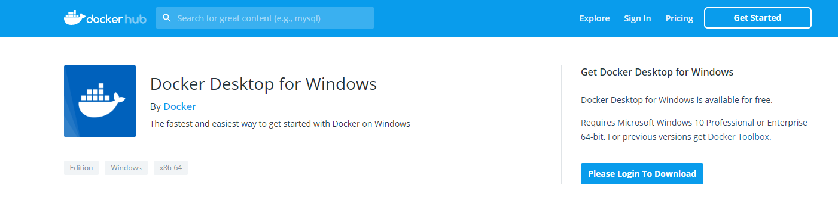
3. Install & run Docker
Step 1: Docker installer can be downloaded from Docker Store only
Enter Docker store:

Slide 8
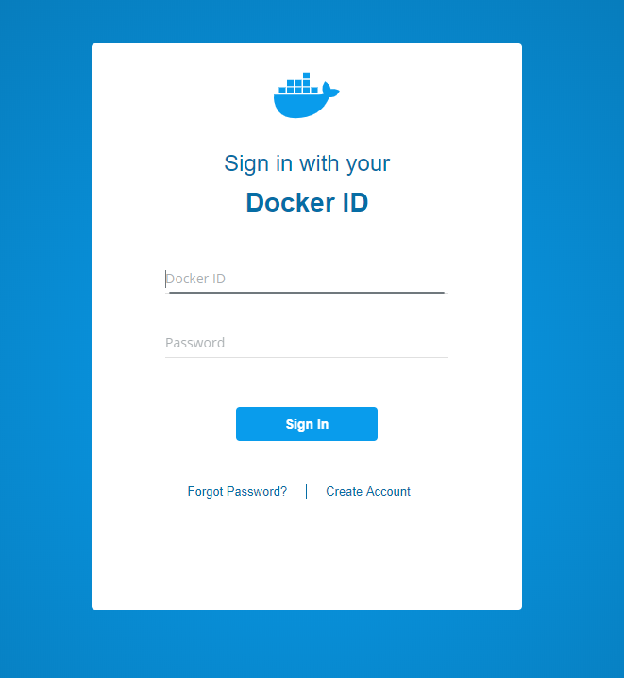
3. Install & run Docker
Step 1: Docker installer can be downloaded from Docker Store only
Login to download:

Slide 9
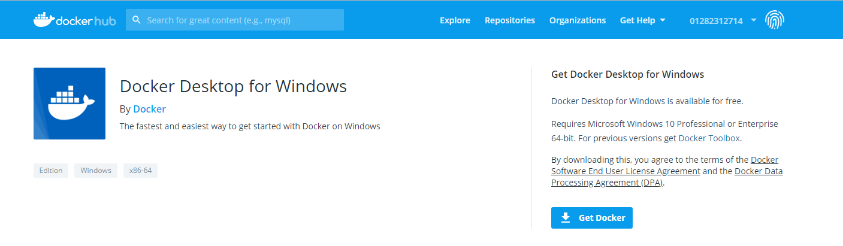
3. Install & run Docker
Step 1: Docker installer can be downloaded from Docker Store only
Ready to download:

Slide 10
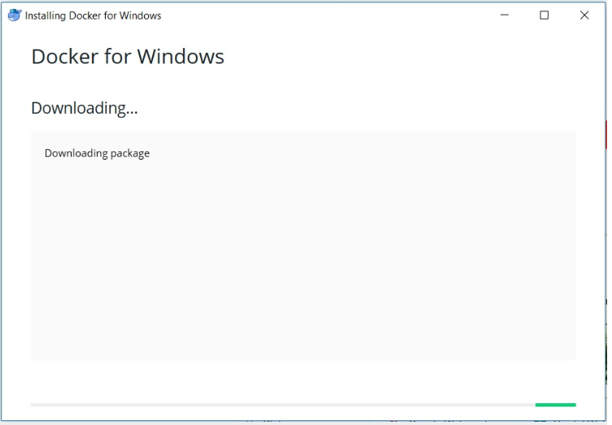
3. Install & run Docker
Step 2: Run the installer
Double click on the download installer file to start the installation Wizard.

Slide 11
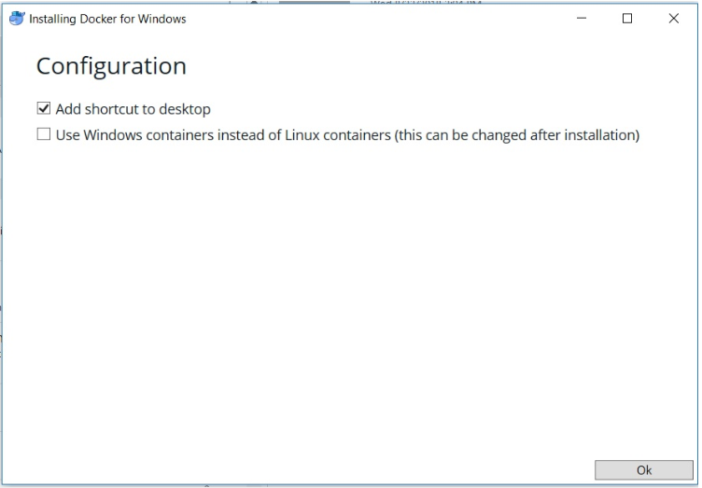
3. Install & run Docker
Step 3: Configuration Settings
Click OK to start the installation. Wait for the installation to complete.

Slide 12
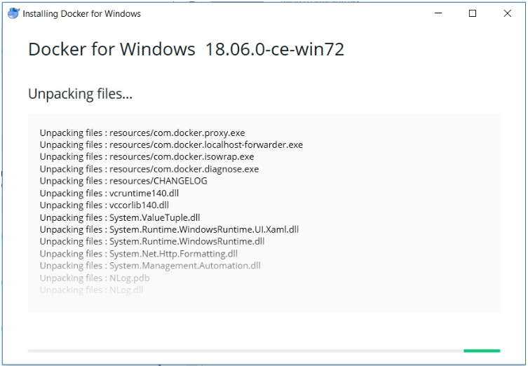
3. Install & run Docker
Step 3: Configuration Settings
Once the installation completes, click on Close to complete the installation.

Slide 13
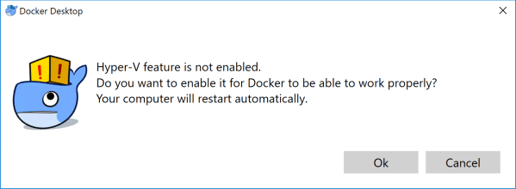
3. Install & run Docker
Step 4: Run Docker
.
Click OK to enable Hyper-V for Docker.

Slide 14
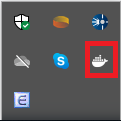
3. Install & run Docker
Step 4: Run docker
Once the installation completes run Docker by double clicking the icon create on the desktop of from start menu.
.
You will see a Docker icon appear on your windows taskbar.

Slide 15
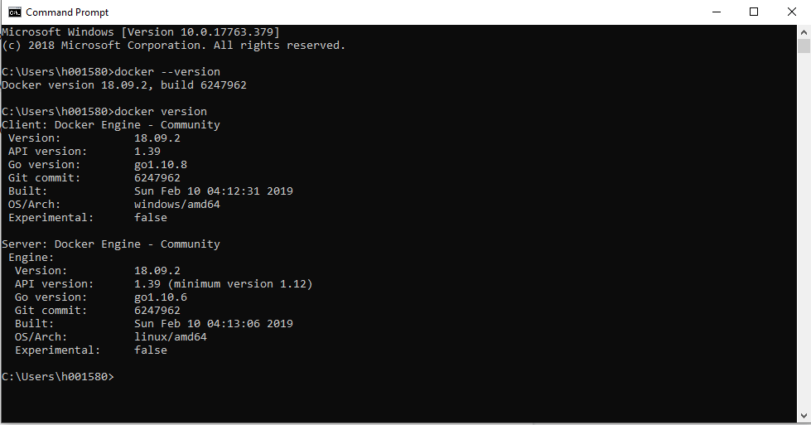
3. Install & run Docker
Step 5: Check the version of Docker Installed
Open Powershell or command prompt and enter the command:
$ Docker version
Then, you will see something like this.
.

Slide 16
II. Docker components
Docker engine.
2. Docker client and server.
3. REST API.
4. Images, Containers, Data volumes.
5. Networks, registries.

Slide 17
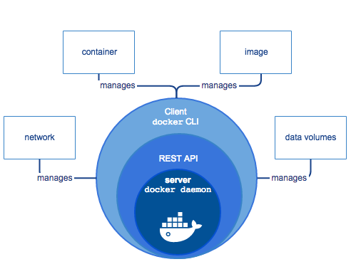
Docker engine
Docker engine is a Client - Server application with these major component
Server: Daemon process( long- running program).
REST API : helps program can talk
to the daemon and instruct
it what to do.
Client: CLI ( command line interface)
uses REST API to control or
interact with Daemon through
scripting or direct CLI commands.

Slide 18
2. Docker Daemon (server)
Listens for Docker API request and manager object.
Can also communicate with other daemons to manage service.
Creates and manages Docker objects such as images, containers, networks, ...

Slide 19
2. Docker Client
The primary way that many Docker users interact with Docker.
The client uses the Docker API to sends these commands to Docker Daemon, when you use command such as ‘docker run’.
Can communicate with more than one daemon.

Slide 20
3. Docker REST API
Docker provides an API for interacting with the Docker Daemon.
Accessed by an HTTP client such as wget or curl, or the HTTP library which is part of most modern programming languages.

Slide 21
4. Docker images
A read-only template with instruction for creating a docker container
To build your images, you create a dockerfile with sample syntax for defining steps to create image and run it.

Slide 22
4. Docker Container
A containers is a runnable instance of an image. You can create, start, stop,...
You can connect a container to one or more network, attach storage to it.
A container is defined by its image as well as any configuration options you provide to it.

Slide 23
4. Docker Data Volumes
General
Volumes are stored in part of the host filesystem which is managed by Docker.
Volumes are the best way to persist data in Docker. When you mount the volume into a container, this directory is what is mounted into the container.
Good use cases for bind mounts
Sharing configuration files from the host machine to containers.
Sharing source code or build artifacts between a development environment on the Docker host and a container.
When the file or directory structure of the Docker host is guaranteed to be consistent with the bind mounts the containers require.

Slide 24
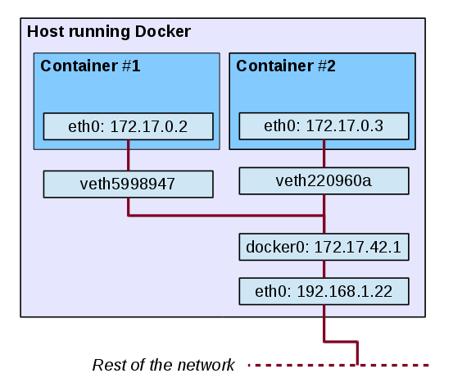
5. Docker network
When we set up Docker, the following settings will be made:
Virtual docker() bridge will be created.
Docker find a subnet which is not used on the host and assign an address to docker().

Slide 25
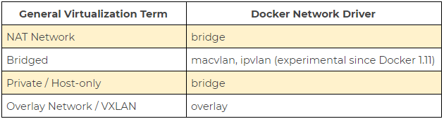
5. Docker network.
Default networks:
Docker will create three default network cards: bridge - host - none.
Docker also have different network drives for alternating other virtualized algae background.

Slide 26
5. Docker network.
User-defined networks:
We can define network ranges that are suitable for our work.
Each network container can communication with other containers in the same network.

Slide 27
6. Registries.
A Docker Registry stores images.
Docker hub is a public registry that anyone can use, and Docker is configured to look for images on Docker Hub by default.
When you use the Docker run and docker pull commands, the required images are pulled from your configured registry.
With Docker Datacenter, it includes Docker Trusted Registry.

Slide 28
III. Distribution tools
Docker hub
2. Use official repositories.
3.Docker command
4. Docker compose
5. Other Public Reponsitories.

Slide 29
Docker Hub
Docker hub is a cloud-based registry service.
It allows you to link to code repositories, build your images and test them, stores manually pushed images.
It provides a centralized resource for container image discovery, distribution and change management, and workflow automation throughout the development pipeline.

Slide 30
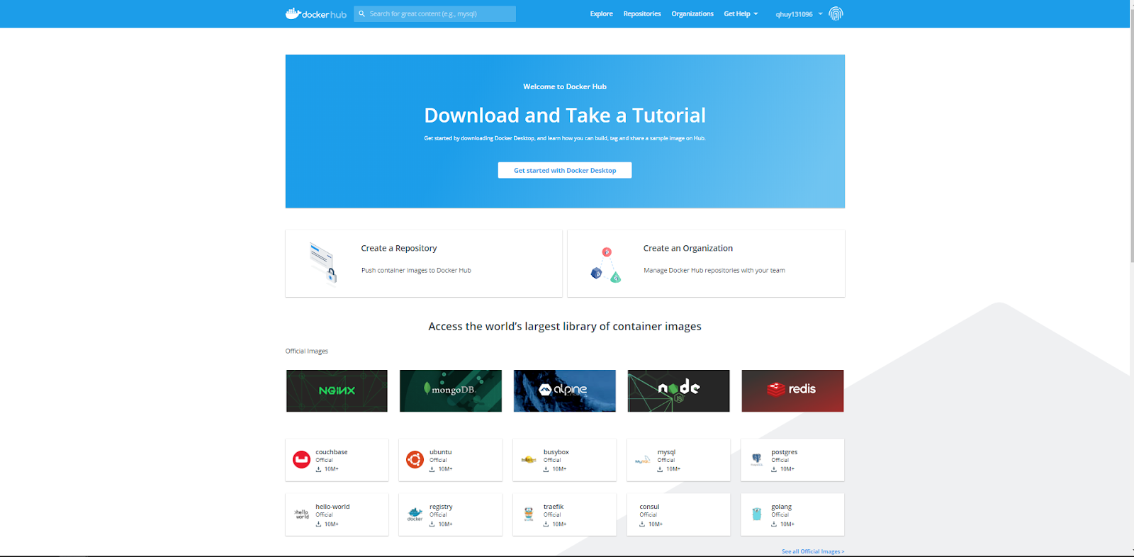
Docker Hub
Log in to Docker Hub and Docker Cloud using Docker ID

Slide 31
Docker Hub
Docker Hub provides the following major features:
Repositories: Push and pull container images.
Teams & Organizations: Manage access to private repositories of container images.
Official Images: Pull and use high-quality container images provided by Docker.
Publisher Images: Pull and use high-quality container images provided by external vendors.
Builds: Automatically build container images from GitHub and Bitbucket and push them to Docker Hub
Webhooks: Trigger actions after a successful push to a repository to integrate Docker Hub with other services.

Slide 32
2. Use official repositories.
Docker Hub contains a number of Official Repositories.
These are public, certified repositories from vendors and contributors to Docker.
With Official Repositories you know you’re using an optimized and up-to-date image that was built by experts to power your applications.

Slide 33
3. Docker command
Docker itself provides access to Docker Hub services via the docker search, pull, login, and push commands.

Slide 34
3. Docker compose
Compose is a tool for defining and running multi-container Docker applications.
Install docker compose:
On desktop systems like Docker Desktop for Mac and Windows, Docker Compose is included as part of those desktop installs.
On Linux systems, first install the Docker for your OS as described on the Get Docker page, then come back here for instructions on installing Compose on Linux systems.
To run Compose as a non-root user, see Manage Docker as a non-root user.

Slide 35
4. Docker compose
The feature of Compose that make is effective are:
Multiple isolated environments on a single host
Preserve volume data when containers are created
Only recreate containers that have changed
Variables and moving a composition between environments

Slide 36
5. Other Public Repositories:
Other companies host paid online Docker registries for public use.
Amazon Elastic Container registry
Google Container Registry
Azure Container Registry
CoreOS Quay
Private Docker Registry

Slide 37
IV. Docker Architectures
Structure
2.Distinguish between
Docker & VMs

Slide 38
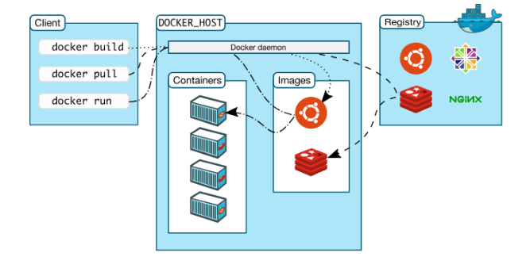
Structure
Docker uses a client- server architecture
Docker consists of 3 main components: Client , host, Registry(Hub)
Docker Daemon: listens for the Docker client through API or CLI
Docker Client: Control most workflow of Docker Daemon
Docker registry: store images.

Slide 39
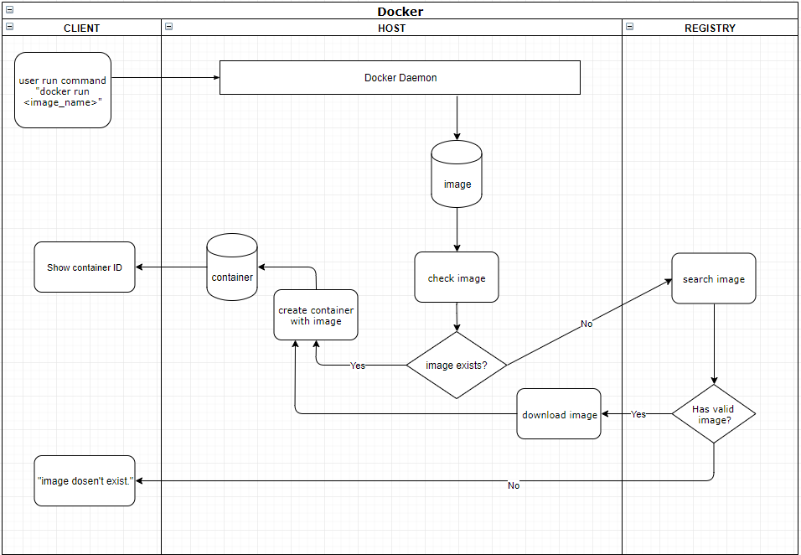
Structure
Example “Docker run <image_name> command

Slide 40
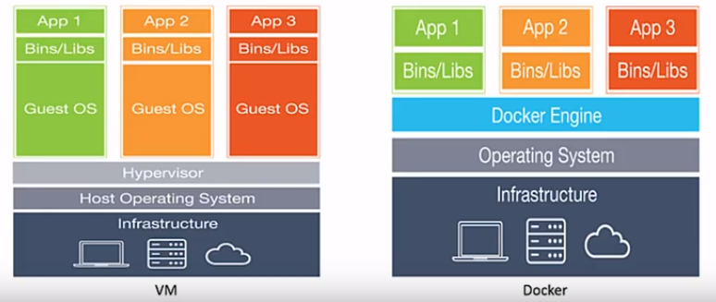
2. Distinguish between Docker and VMs

Slide 41
2. Distinguish between Docker and VMs
The basis of compare between Docker vs VMS | Docker | Virtual Machine
Boot time | Dockers can boot in seconds | It often takes minutes for VMs to boot
Execution | Makes use of execution engine | Makes use of a hypervision
Memory | More memory efficient as no space need to virtualize | less memory efficient as the entire OS needs to be loaded before starting the service

Slide 42
2. Distinguish between Docker and VMs
The basis of compare between Docker vs VMS | Docker | VIrtual Machine
Isolation | No provision for isolation of system and hence are more prone to adversities | Efficient isolation mechanism and hence interference possibility is less
Ease of deployment | Deploying through dockers is extremely easy as only one image, containerized, can be used across different operating systems | Deploying in VMs is a comparatively lengthy process where separate instances are responsible for the execution
Ease of usage | Docker have comparatively complex usage mechanism which consists of both third party and docker managed tools | The tools associated with a VM are comparatively easier to use and simpler to work with

Slide 43
V. Docker Cheat sheet
1.Run
2.Build
4. Remove

Slide 44
Run
To create and run a container:
docker run --name container_name docker_image
Other useful flags:
-d: Detach container on start (Running in background)
- rm: Remove container once it stops.
-p : Publish host IP and host port to the container port
-v: Define and share volume across containers
-- read-only: Sets containers to be read only.

Slide 45
2. Build
To pull an image from the Registry, define image_name
docker pull image_name: tag
To build an image from your Dockerfile
docker build -t image_name: tag
If you don’t want your container to auto use:
docker create --name container_name image_name: tag
Start and stop container commands
docker start container_name
docker stop container_name

Slide 46
3. Remove
To remove one or more container
docker rm container_name
To remove one or more image
docker rmi image_name

Slide 47
V. Demo for web
Environment
2. Install and run
Web app.

Slide 48
Environment
Docker
Docker: Docker version 18.09.2, build 6247962
Docker compose: docker-compose version 1.23.2, build 1110ad01
Docker machine: docker-machine.exe version 0.16.1, build cce350d7
OS
Windows 10: Windows Pro 64-bit (10.0, Build 17763)

Slide 49
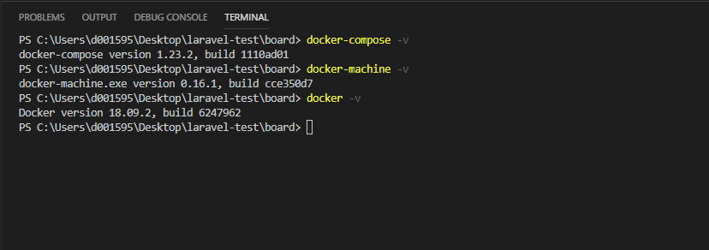
Environment
OS
Windows 10: Windows Pro 64-bit (10.0, Build 17763)

Slide 50
Environment
Laravel
Webserver: Nginx 1.17.1
PHP: 7.2-fpm
MySql: 5.7.22

Slide 51
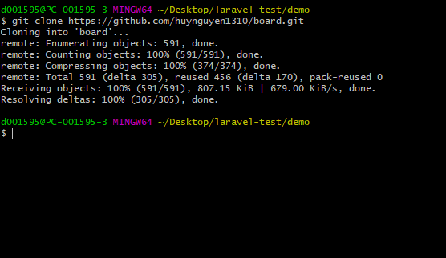
2. Install and run Web app
Step 1: Downloading Laravel
$ git clone https://github.com/huynguyen1310/board.git

Slide 52
2. Install and run Web app
Step 2: Creating the Docker File:
docker-compose.yml: defines our web server, database, and application service.
dockerfile: enables you to create custom images that you can use to install the software require by your application.
nginx/config.d/app.conf: you can modify the Nginx service to use PHP-FPM as the FastCGI server to server dynamic content
mysql/my.cnf: this is the file that you bind-mounted to /etc/mysql/my.cnf inside the container.

Slide 53
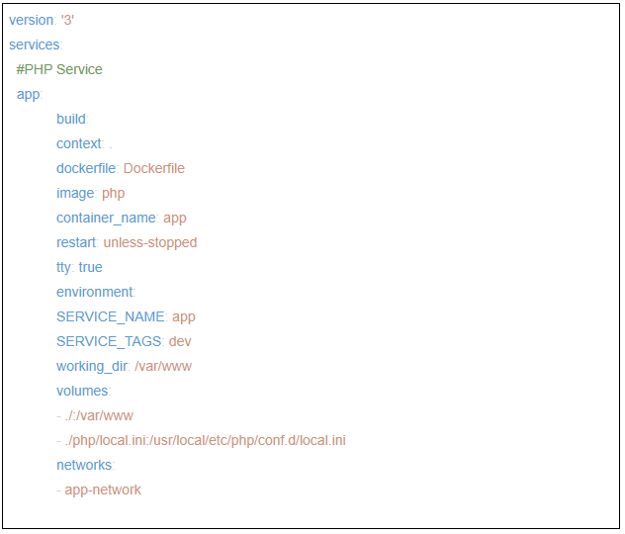
2. Install and run Web app
Step 2: Creating the Docker File: docker-compose.yml
PHP service:
Some explanation:
version 3: version of docker-compose
context : dockerfile directory
dockerfile: describes which image will be used be service,...
working_dir: where the app code will be inside the container
volumes: mount directory on host into /var/www

Slide 54
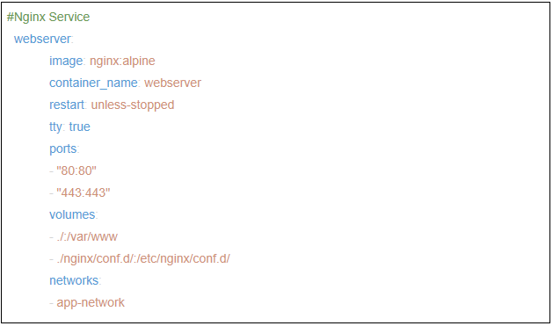
2. Install and run Web app
Step 2: Creating the Docker File: docker-compose.yml
Web server service:
Some explanation:
port - 80:80 : map port 80 on the virtual machine to port on the container.

Slide 55
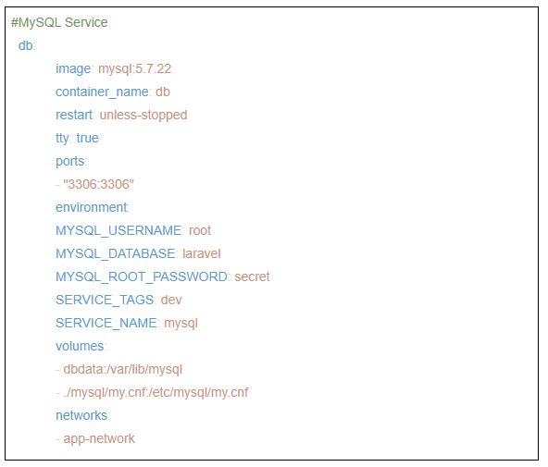
2. Install and run Web app
Step 2: Creating the Docker File: docker-compose.yml
Data service:
Some explanation:
image:mysql: 5.7.22 : mysql service version
dbdata:/var/lib/mysql : create a name volume
environment : Environment variable.
We used laravel as the database, root as username, secret as the password.

Slide 56
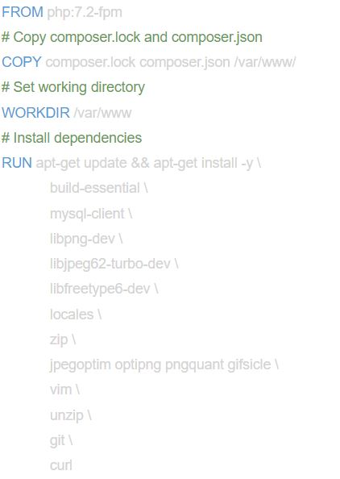
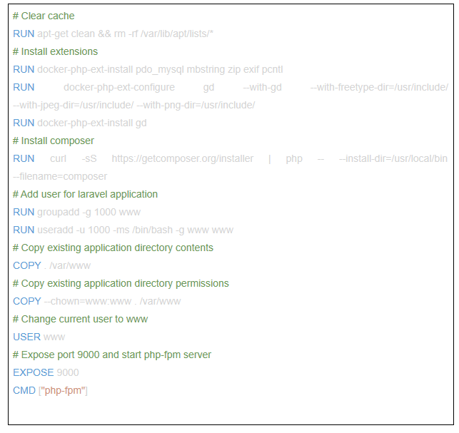
2. Install and run Web app
Step 2: Creating the DockerFile: dockerfile

Slide 57
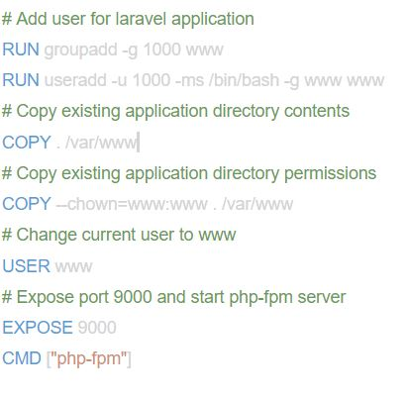
2. Install and run Web app
Step 2: Creating the DockerFile: dockerfile
The Dockerfile creates an images on top of the php:7.2-fpm Docker image.
The file also installs the prerequisite packages for Laravel mcrypt, pdo_mysql, mbstring, and imagick with composer.
The RUN directive specifies the commands to update, install, and configure settings.
Creating a dedicated user and group with restricted permissions mitigates the inherent vulnerability.
The EXPOSE command exposes a port in the container for the php-fpm server.
CMD specifies the command that should run once the container is created

Slide 58
2. Install and run Web app
Step 2: Creating the DockerFile: Configuring Nginx:
To configure Nginx, you will create an app.conf file with the service configuration in the ~/nginx/conf.d/ folder.
Next, create the app.conf configuration file

Slide 59
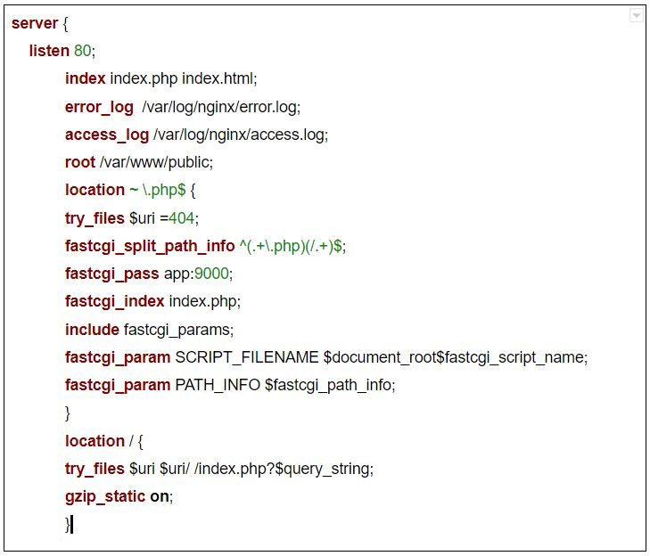
2. Install and run Web app
Step 2: Creating the DockerFile: Configuring Nginx
The server block defines the configuration for the Nginx web server with the following directives:
listen: This directive defines the port on which the server will listen to incoming requests
error_log and access_log: these directives define the files for writing logs
root: This directive sets the root folder path, forming the complete path to any requested file on the local file system

Slide 60
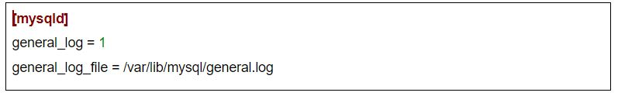
2. Install and run Web app
Step 2: Creating the DockerFile: Configuring mySQL.
you will create the my.cnf file in the mysql folder.
This is the file that you bind-mounted /etc/mysql/my.cnf inside the container.
In the file, add the following code to enable the query log and set the log file location

Slide 61

2. Install and run Web app
Step 3: Running the Containers and Modifying Environment Settings
Make a copy of the .env.example file that Laravel includes by default and name copy .env
$cp .env.example .env
Start all of the containers, create the volumes and set up and connect the networks
$docker-compose up -d

Slide 62
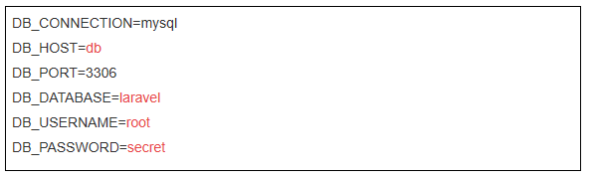
2. Install and run Web app
Step 3: Running the Containers and Modifying Environment Settings
Update the .env file, find the block that specifies DB_CONNECTION and update it to reflect the specifics of your setup.

Slide 63
2. Install and run Web app
Step 3: Running the Containers and Modifying Environment Settings
Use Docker’s composer image to mount the directories that you will need for your Laravel project.
Avoid the overhead of installing Composer globally:
$docker run --rm -v /$(pwd):/app composer install
Set the application key for the Laravel application with the php artisan key:generate command.
$docker-compose exec app php artisan key:generate

Slide 64

2. Install and run Web app
Step 3: Running the Containers and Modifying Environment Settings
To cache these settings into a file, which will boost your application’s load speed, run:
$docker-compose exec app php artisan config:cache
Configuration settings will be loaded into /var/www/bootstrap/cache/config.php on the container.

Slide 65
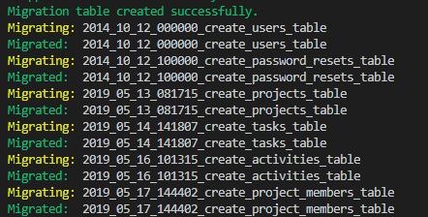
2. Install and run Web app
Step 3: Running the Containers and Modifying Environment Settings
test the connection to MySQL by running the Laravel artisan migrate command, which creates migrations table in the database from inside the container:
$docker-compose exec app php artisan migrate
As final step, visit http://localhost:80 in the browser. You will see the following home page for your Laravel application.

Slide 66
T
___
___
hank you
for
your
A
ttention

